Slide 1
Children Poverty Action Lab

Slide 2
Outline
Methodology
Poverty distrubution
Percentage accessibility of jobs within living wage
By driving – 30 mins / 60 mins
By transit – 30 mins / 60 mins
Grocery stores
Basic clinics
Women’s clinics
WIC centers

Slide 3
Methodology
Select geocode of Dallas city from LODES
SQL
Find the shortest path from work to home and calculate their distance
Python- OpenStreet Map
Measure the commute time by transit and driving
Google API
Compute the percentage of job accessible within specific time
Tableau

Slide 4
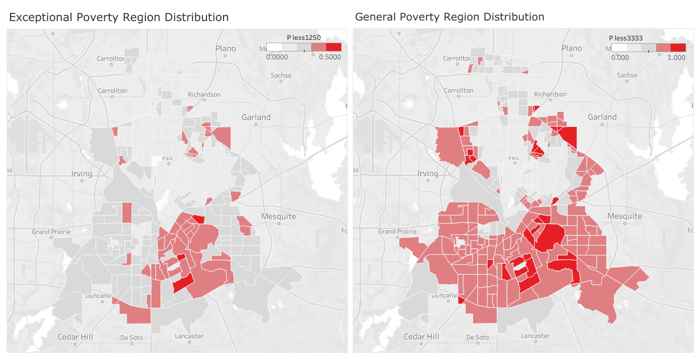
Living wage less than $1250:
White: 10%
Light grey: 20%
Grey:30%
Light red: 40%
Red:50%
Living wage less than
$3333:
White:20%
Light grey: 40%
Grey:60%
Light red: 80%
Red:100%

Slide 5
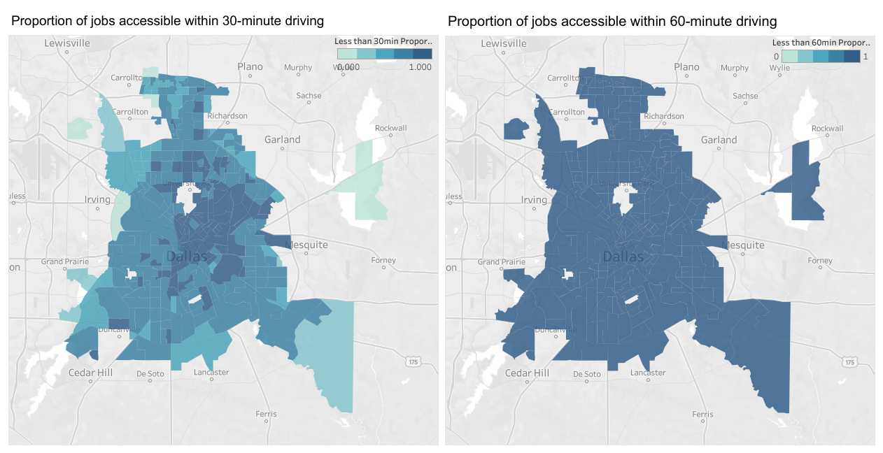
Almost 60% of jobs are reachable for driving.
Almost all jobs can be reached by driving.

Slide 6
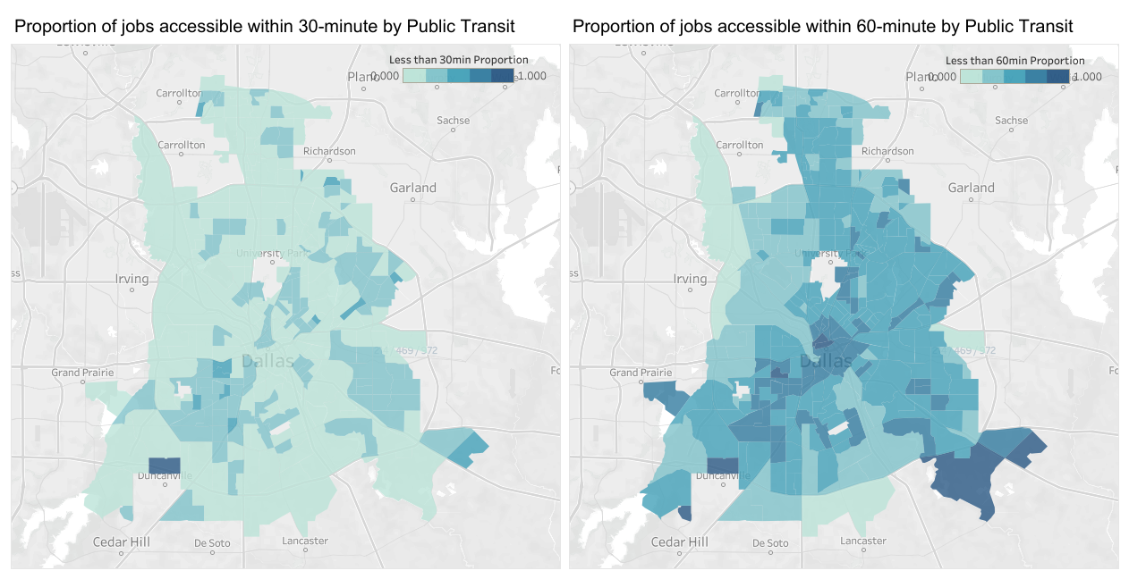
Less than 40% of jobs can be reached by transit.
By transit, about 60% of jobs are accessible, but part of jobs cannot be reached by transit, which is different with driving method.

Slide 7
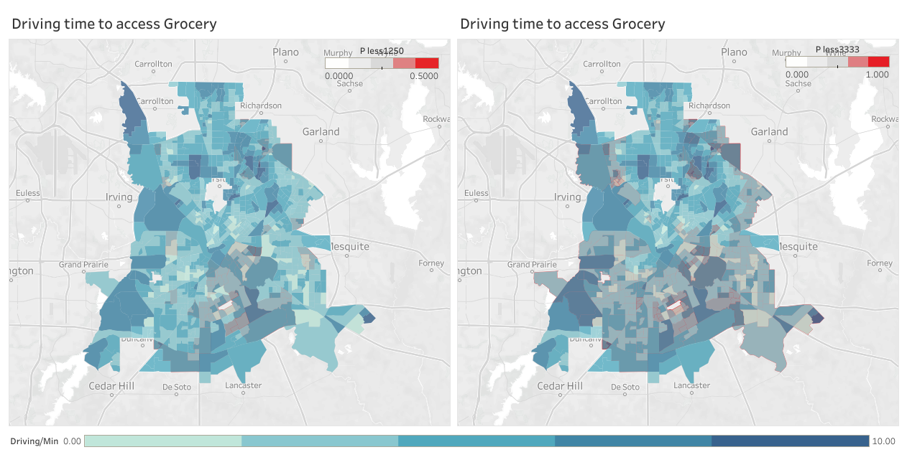

Slide 8
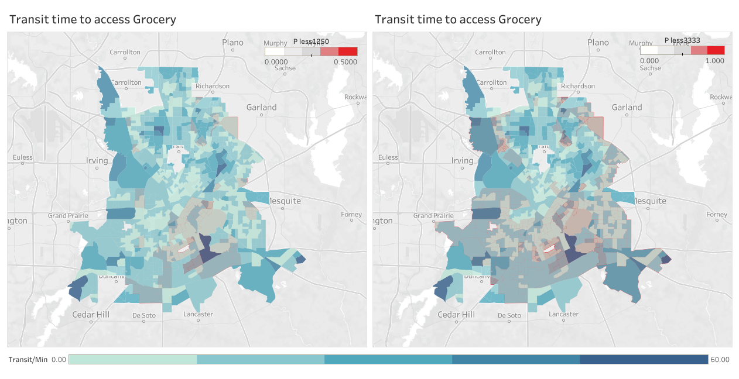

Slide 9
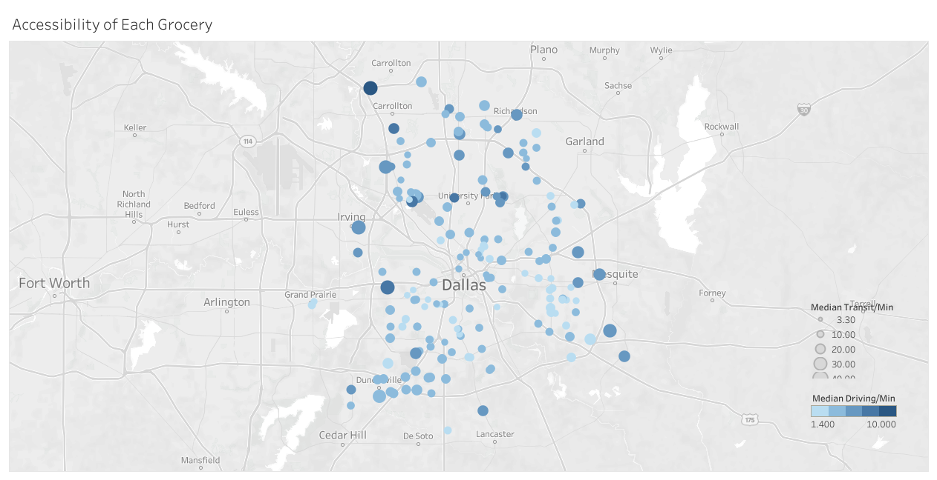
Lighter-colored, smaller dot means driving time will be less when compared to darker-colored, bigger dots.

Slide 10
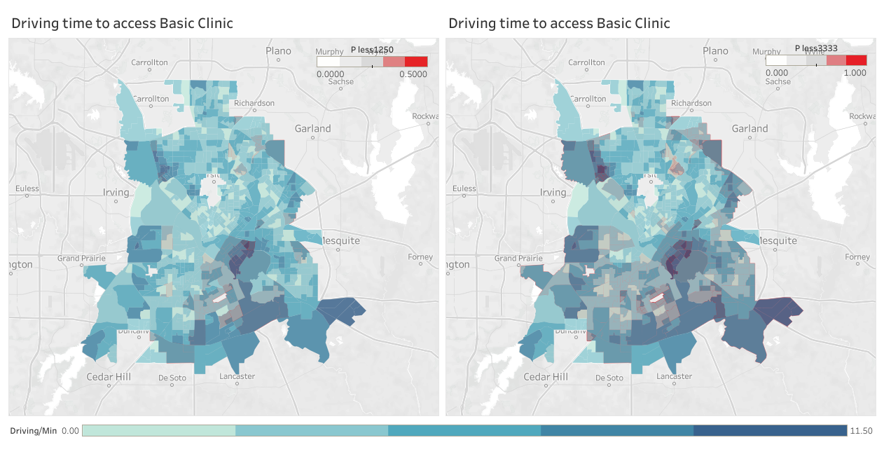

Slide 11
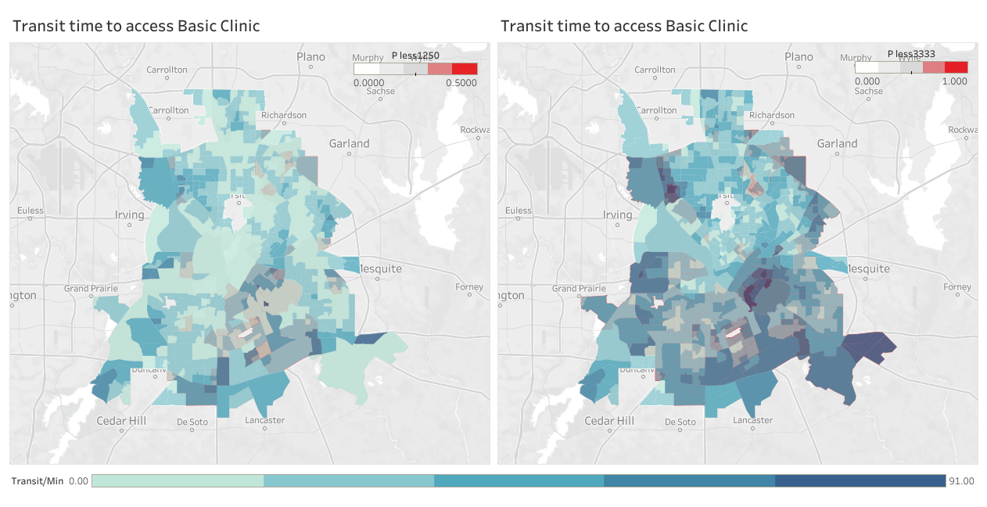

Slide 12
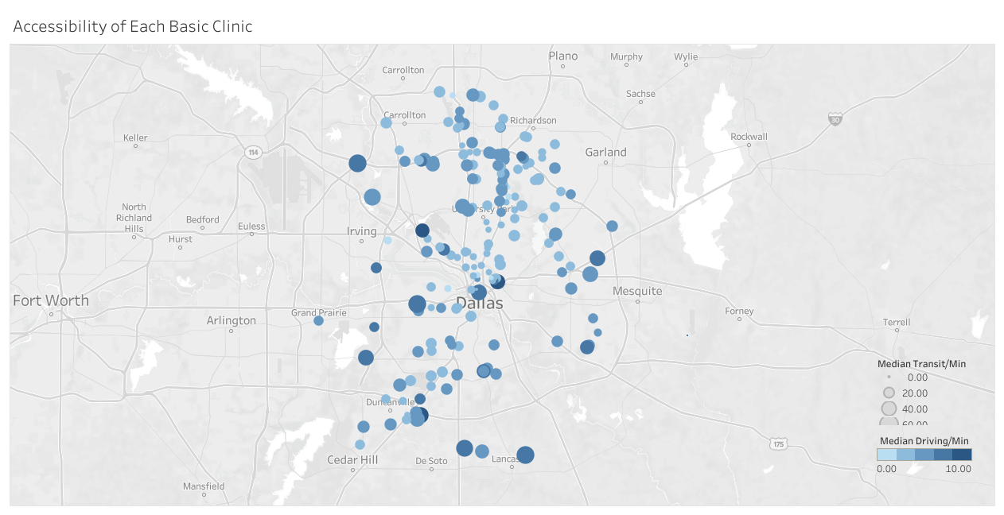
Lighter-colored, smaller dot means driving time will be less when compared to darker-colored, bigger dots.

Slide 13
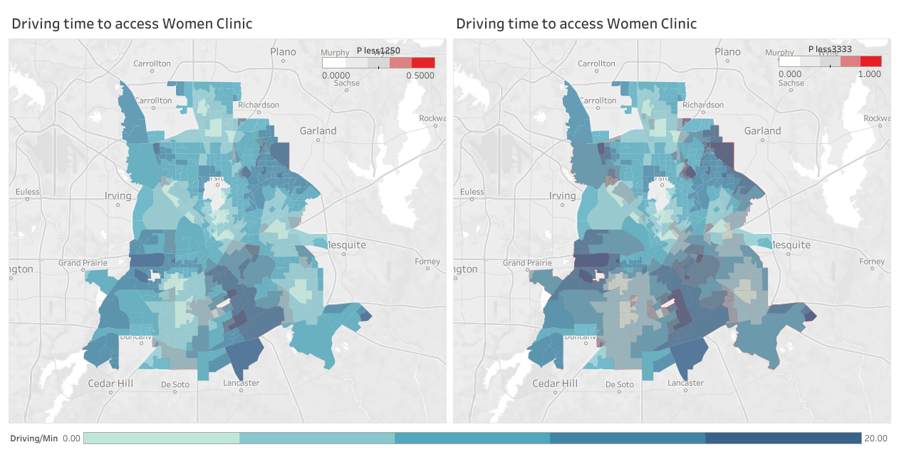

Slide 14
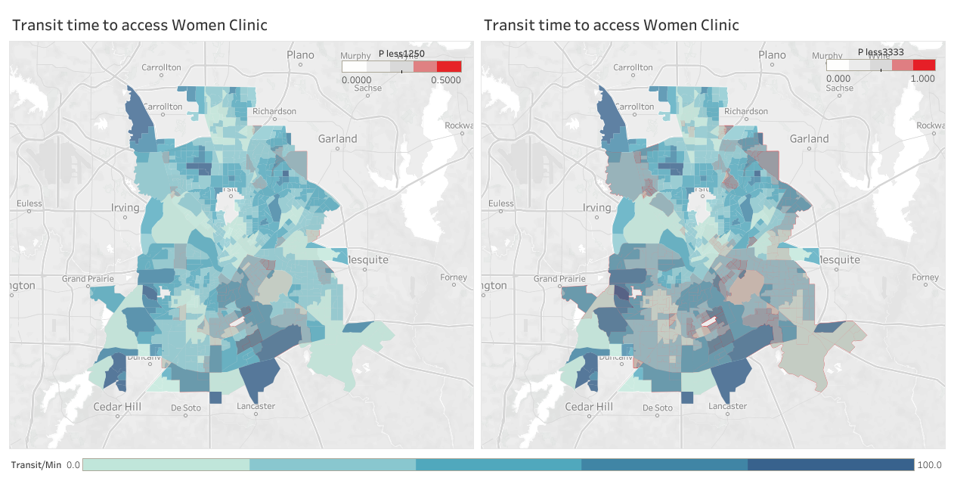

Slide 15
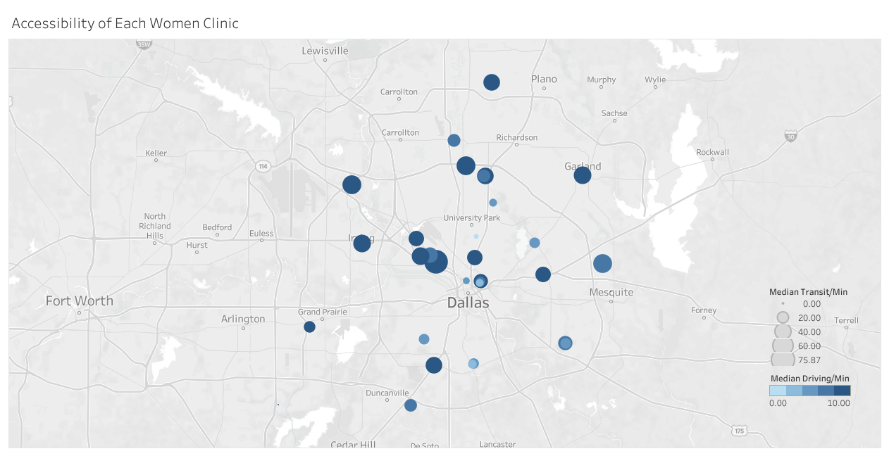
Not like basic clinic and grocery, women’s clinic will be much more difficult to reach for poverty family, because they have more bigger and dark-colored dots than map of basic clinic and grocery.

Slide 16
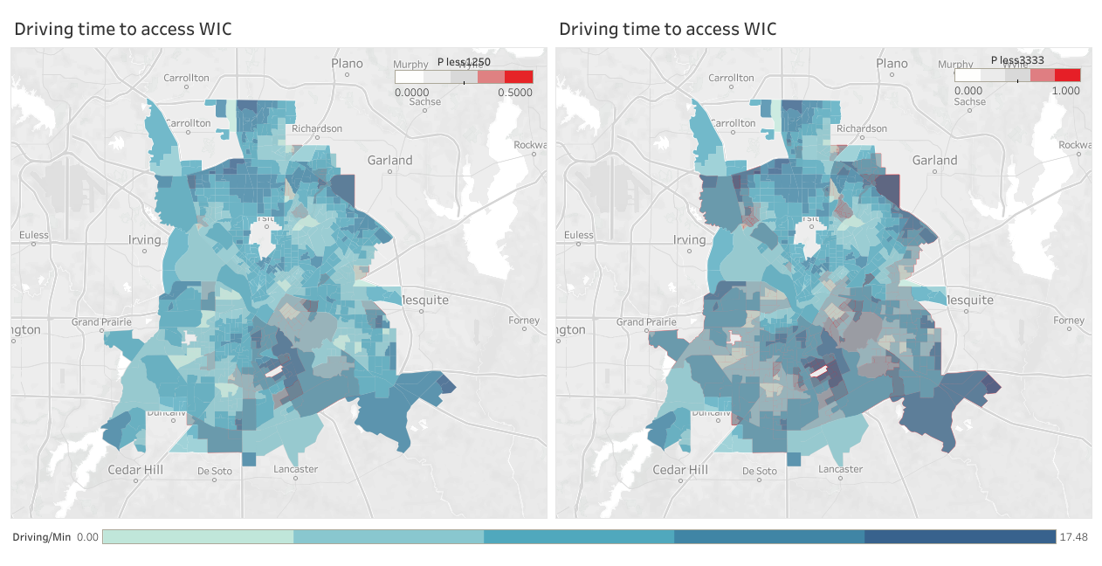

Slide 17
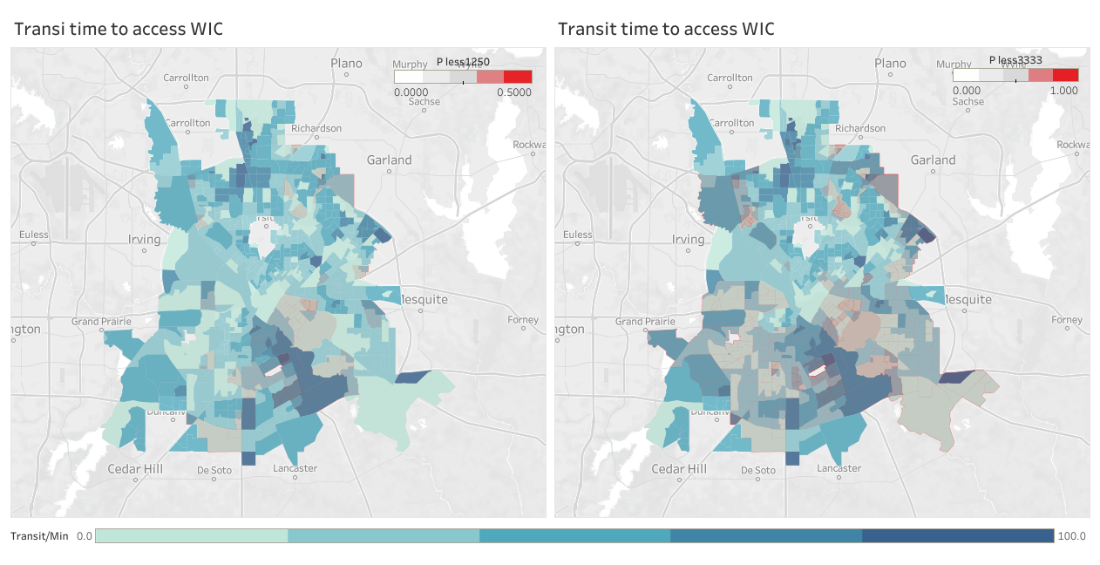

Slide 18
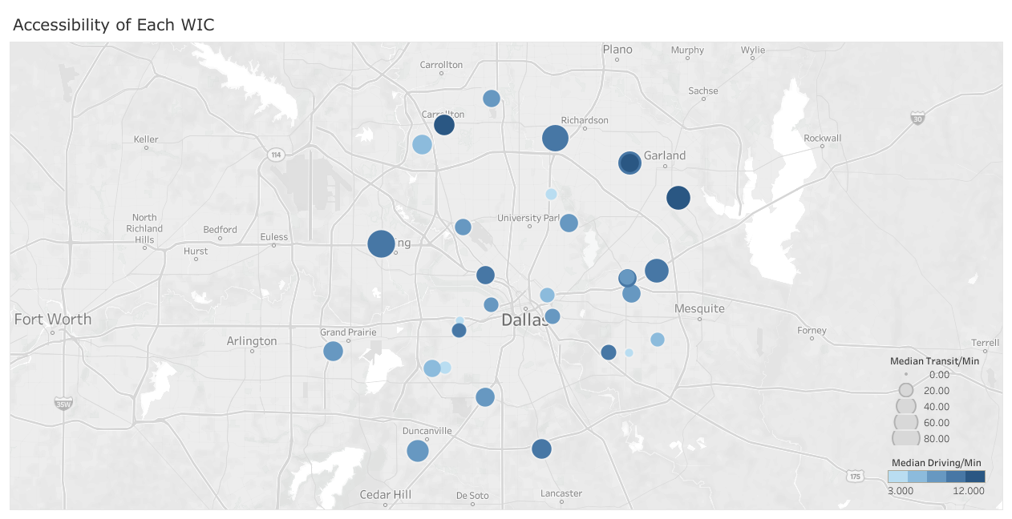
Condition for WIC center will be more severe than women’s clinic, so we have to put more attention and effort on women’s clinic and WIC center to take care of poverty family.

Slide 19
Solutions for children poverty
Build firm near-by dormitory
More flexible dart line
Send subsides to low income family
Set preferential policies to subsidize poor families

Slide 20
THANK YOU!

